Slide 1
Evaluation Metrics

Slide 2
How to evaluate a prediction
h(x) = y hat
Y is the actual value
Error if both are different
To measure error
  Absolute error
    on a single training example |h(x)-y|
    On multiple training example 1/n ∑|h(x)-y|
  Sum of squares error
    1/n ∑ (h(x)-y)²
These absolute and sum of squares error are specially useful in case of regression
For classification we look at the number of misclassifications
  1/n ∑ δ (h(x), y) where δ (h(x), y) is 0 if h(x) and y are same and 1 if they are same

Slide 3
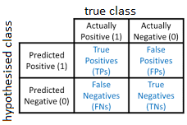
Confusion matrix
In case of classification problem it is helpful
For three class classification
  3x3 matrix
  Diagonal entries are where the learning algorithm is giving the correct results
  Non-diagonal entries are where the learning algorithm is given the non correct results

Slide 4
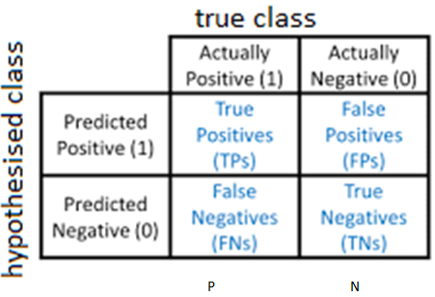
Other evaluation metrics
Accuracy
  Correct examples out of all examples
  (TP +TN)/ (TP+TN+FP+FN)
Precision
  Accuracy of positive predictions
  TP/(TP+FP)
  A trivial way to have perfect precision is
    To make one single positive prediction and ensure it is correct precision=(1/1=100%)
Recall/ Sensitivity/ true positive rate (TPR)
  Ratio/proportion of positive instances that are correctly predicted by the classifier.
  TP/ (TP+FN)= (TP/P)
Specificity/ True negative rate (TNR)
  Ratio/proportion of true negatives that are correctly predicted by the model
  TN/(TN + FP)= (TN/N)
False Positive rate (FPR)
  Ratio/proportion of actual negative cases that are incorrectly predicted as positive by the classifier
  FP/ (FP + TN)= (FP/N)

Slide 5
Other evaluation metrics
F1 score
  Combines precision and recall to a simple way to compare two classifiers.
  Harmonic mean of precision and recall.
  favours classifiers that have similar precision and recall.
Whereas the regular mean treats all values equally, the harmonic mean gives much more weight to low values.
As a result, the classifier will only get high F1 score if both precision and recall are high.
F1= 2/((1/Precision)+(1/Recall))= 2. [(Precision.Recall)/(Precision+Recall)]

Slide 6
Precision-Recall tradeoff
F1 favours classifiers that have similar precision and recall.
Many times we don’t want both Precision and Recall to be high
Sometimes we mostly care about precision, and in other contexts we really care about recall.
Example:
  classifier to detect videos that are safe for kids
    We want a classifier with High precision and don’t want a classifier with high recall (we want 0 False positives) (in this case positive is –safe video)
  Classifier to detect shoplifters on surveillance images
    Classifier with low precision (the security guard will get a few false alerts) but high recall (almost all shoplifters will get caught) would be fine (We want 0 False negative)
Unfortunately, you can’t have it both ways: increasing one will reduce the other.

Slide 7
Receiver Operating Characteristic (ROC) curve
The ROC curve is generated by plotting the TPR (sensitivity or recall) against the FPR at various classification threshold settings
Classification threshold
  the model usually assigns a probability score or a continuous value to each instance, indicating the likelihood of it belonging to one of the classes.
  To make a binary decision, this continuous value needs to be converted into a discrete decision, typically by choosing a threshold.
  For example, if the threshold is set at 0.5,
    any instance with a predicted probability above 0.5 would be classified as positive, and
    any instance with a predicted probability below 0.5 would be classified as negative.
  Adjusting this threshold affects the trade-off between the true positive rate (sensitivity) and the false positive rate (1-specificity) and consequently affects the shape of the ROC curve

Slide 8
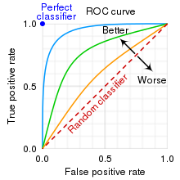
Receiver Operating Characteristic (ROC) curve

Slide 9
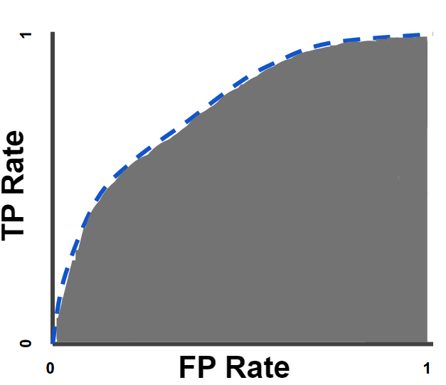
AUC (Area under the ROC Curve)
A perfect classifier would have an ROC curve that passes through the top-left corner of the plot (TPR = 1, FPR = 0), indicating high sensitivity and specificity.
The area under the ROC curve (AUC) is a commonly used metric to quantify the overall performance of the classifier.
AUC provides an aggregate measure of performance across all possible classification thresholds.
AUC ranges in value from 0 to 1.
A perfect classifier would have an AUC of 1
A model whose predictions are 100% wrong has an AUC of 0.0
A random classifier would have an AUC of 0.5.
A higher AUC indicates better overall performance of the classifier across all possible thresholds.

